Slide 1
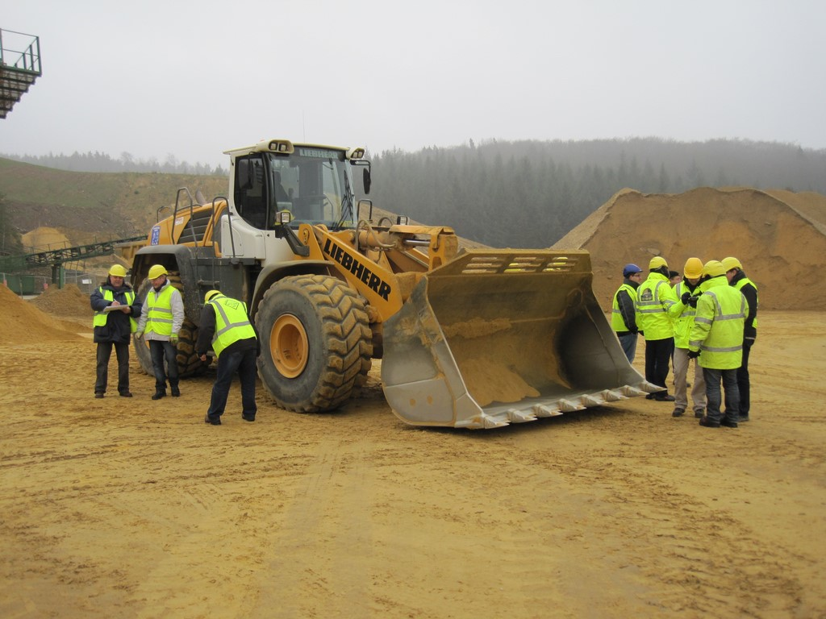
EM Track III
07-2015

Slide 2
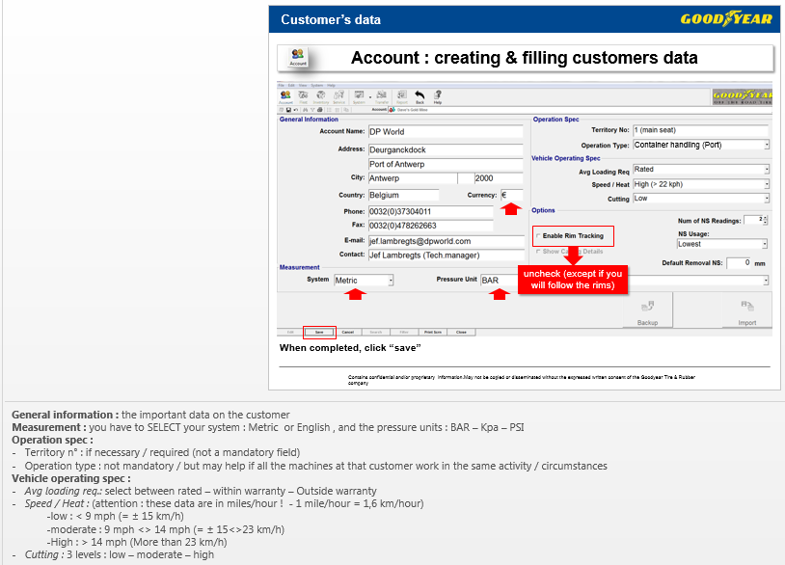
FYI
Introduction :
There many slides where additional comments are available, with more details than on the views.

Slide 3
What is EM Track III ?
EM Track III Overview
EM track III is a windows based (Access) tire records system
Multiple customers can be maintained at same time
Share customers data with co-workers, your manager, etc.
Import data from your colleagues, your manager, etc…
System will track a tire’s life from cradle to grave, in every circumstance
Complete reporting features (Visit reports, forecast…)
Cost analysis ,between tires manufacturers, tread designs, vehicles types, wheel positions, compounds, applications, etc…
Can track tires & rims

Slide 4
Overview : languages
This program is available in different languages :
English (US/Canada)
English (UK/Australia)
Spanish
Italian
French
Chinese
To change :
Select language
Notes:
System > select your language

Slide 5
Program start : The 1st page

Slide 6
Start page
EM Track III - entry
Customers / users list & data
Machines / vehicles management
Tires & Rims management
Tires follow-up : Mountings / dismountings, inspections / measurements, inflation pressure, etc…

Slide 7
Start page
EM Track III - entry
Tires & machines movements between customers
Summaries, historic , forecast

Slide 8
Shortcuts
Shortcuts to specific chapters
Chapter | Shortcut
Account management | F2
Fleet management | F3
Inventory management | F4
Vehicle services | F5
Table maintenance | F6
Equipment transfer | F8
Reports & graphs | F9
Print Screen (select your printer) | Ctrl+P
Back | F12

Slide 9
Process
EM Track III Overview : process
Create a customer
Create a machine
Create the tires and rims (if required)
Install the tires on the machine
Manage the tires (mounting, inspection, dismounting, storage, replacement, repairs , retreads, scrap,…)
Fill the data / measurements
Establish reports

Slide 10
Process
EM Track III : process
Create user
User
Reports
Create vehicles
Tires survey
Create tires
Install tires

Slide 11
Accounts
1.account

Slide 12
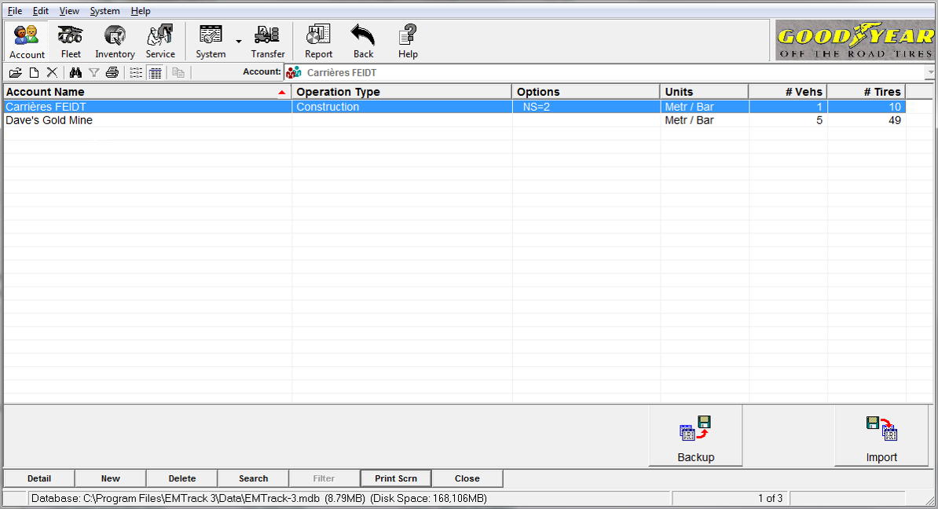
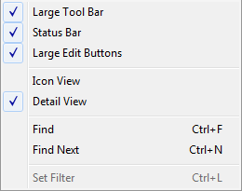
Customers list
Account : creating & filling customers data
Select “view”
> Large Edit Buttons
(Existing customers)
Notes:
Attention : DELETE > “If you delete this accounts, all vehicles and tires to this account will no longer be available. Are you sure you wish to delete ?”

Slide 13
Customers list
Account : creating & filling customers data
(Existing customers)
To add a new customer, click here or here
Notes:
Attention : DELETE > “If you delete this accounts, all vehicles and tires to this account will no longer be available. Are you sure you wish to delete ?”

Slide 14
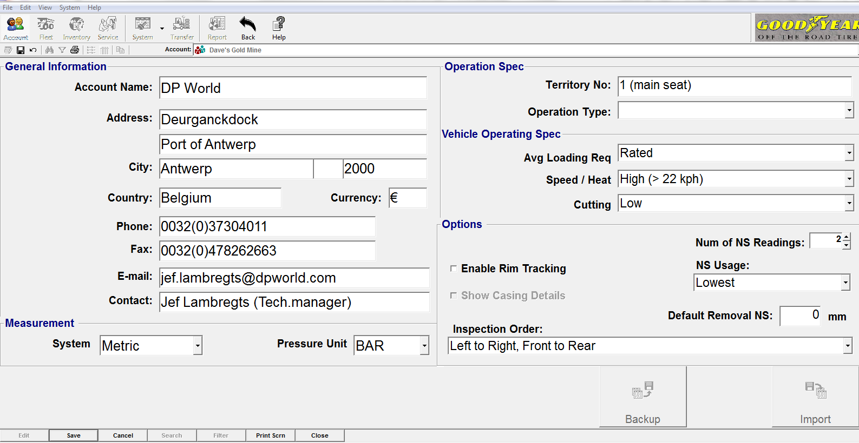
Customer’s data
Account : creating & filling customers data
Container handling (Port)
uncheck (except if you will follow the rims)
“Save” to finish
Notes:
General information : the important data on the customer
Measurement : you have to SELECT your system : Metric or English , and the pressure units : BAR – Kpa – PSI
Operation spec :
Territory n° : if necessary / required (not a mandatory field)
Operation type : not mandatory / but may help if all the machines at that customer work in the same activity / circumstances
Vehicle operating spec :
Avg loading req.: select between rated – within warranty – Outside warranty
Speed / Heat : (attention : these data are in miles/hour ! - 1 mile/hour = 1,6 km/hour)
-low : < 9 mph (= ± 15 km/h)
-moderate : 9 mph <> 14 mph (= ± 15<>23 km/h)
-High : > 14 mph (More than 23 km/h)
Cutting : 3 levels : low – moderate – high
Options :
Num of Non Skid readings : at least 2…(to prevent from irregular wear, for ex.)
NS usage : (which RNS must be taken in consideration) First – average – highest – lowest
Enable rim Tracking : if you only follow the TIRES (this is our job), uncheck this box, otherwise you’ll have first to mount a tire on a rim before mounting this assembly on a machine and manage it. (See further)

Slide 15
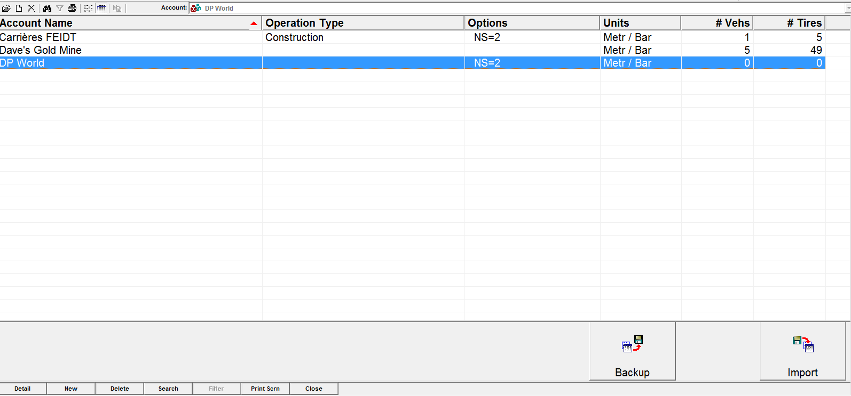
Accounts
Account : creating & filling customers data
The customer has been created and appears now in your accounts list
To modify customer’s data, double click on the name’s line, or click on “detail”, and, on the customer editor screen, click “edit”.

Slide 16
Vehicles & machines
2.vehicles

Slide 17
Vehicles & machines
Vehicle editor screen
Check the customer
To modify a vehicle,
Double click on the line, or click “detail”
(Machines already registrated)
To add a new vehicle, click “New”
Notes:
Select the right customer > you’ll the existing vehicles list (if there are already machines which have been previously created)
Modify a machine
Add a new machine (click on “NEW”)

Slide 18
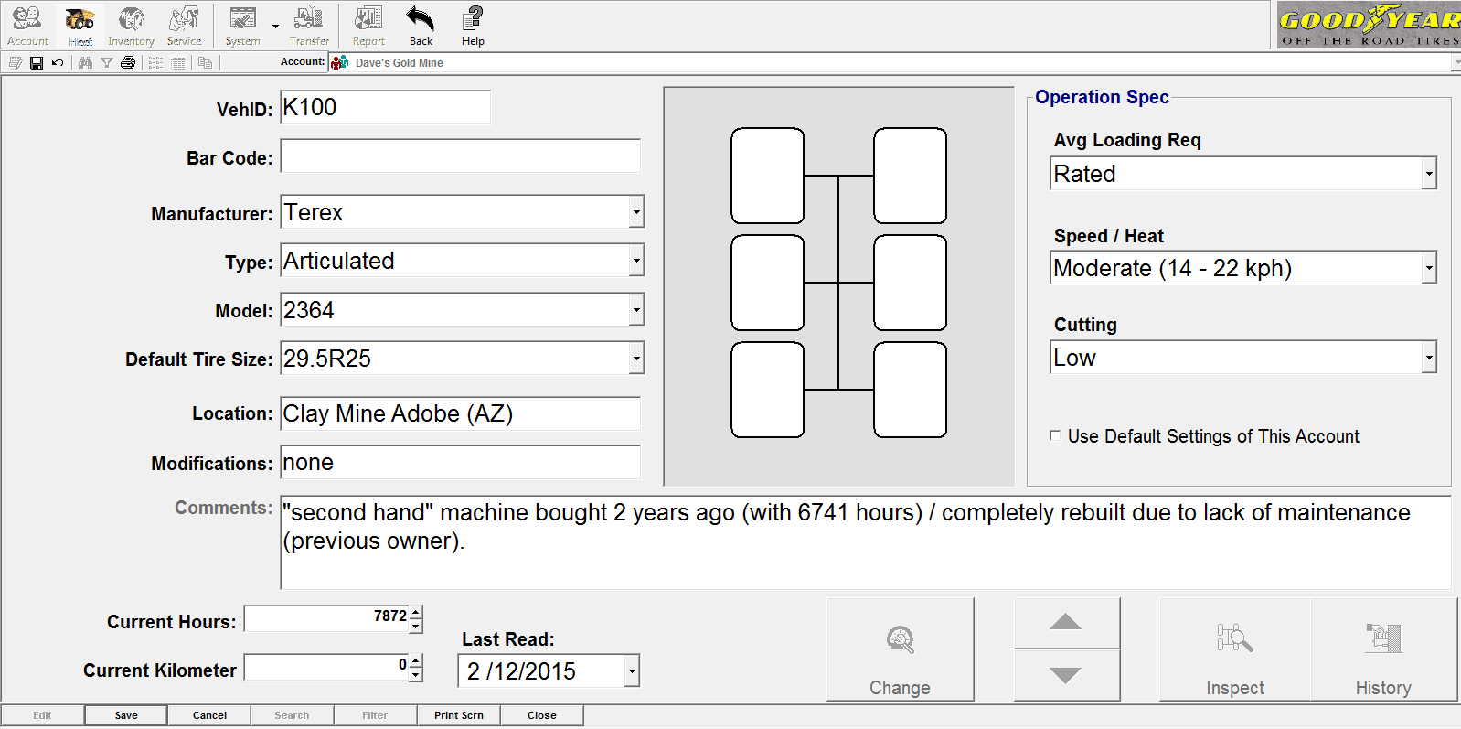
Vehicles & machines
Vehicle editor screen
Enabling / disabling the overall service conditions filled in the customer’s edition screen
Here you can add comments on this machine
“Save” to finish
Notes:
EDIT the vehicle : not possible to change the “COMMENTS” area !

Slide 19
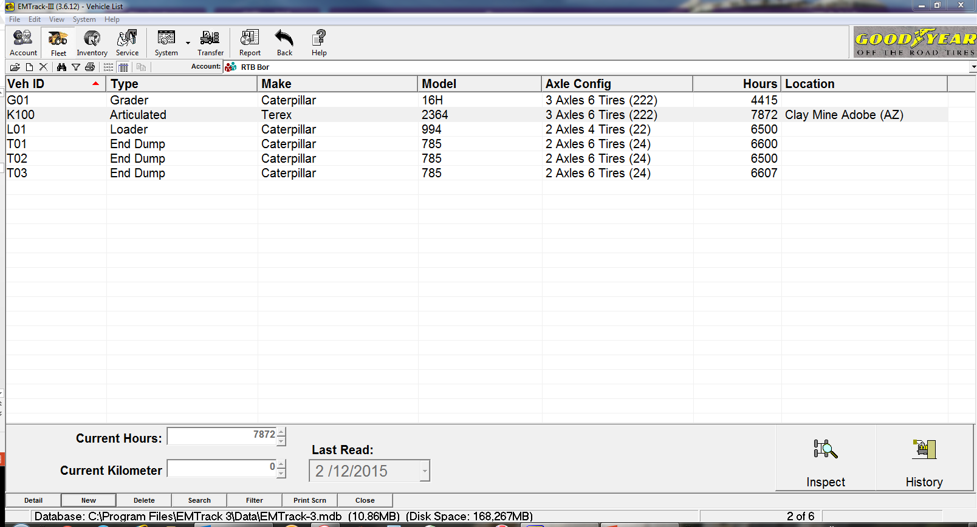
Vehicles & machines
Vehicle editor screen
The vehicle has been
created and appears in the customer’s list
Notes:
If we click “Inspect”, this is what we will see.

Slide 20
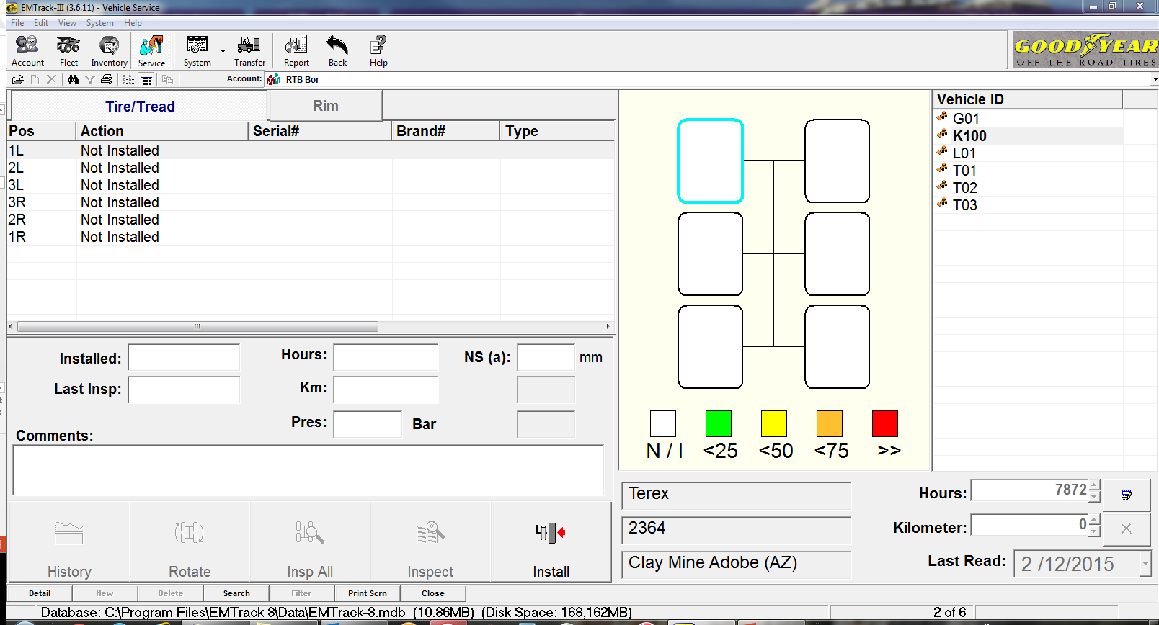
New vehicle added
Vehicle editor screen
No tires fitted on that vehicle yet
Notes:
No tires on the machine / next step will be “fit tires on the machine”
Go to “INVENTORY” :
Either you fitted available tires from the inventory on the machine ;
Or you have to create tires if they don’t exist in the customer’s stock.

Slide 21
Vehicles brands & models
Vehicle editor screen
Not all the brands and models
are available
> Click “System” (or F6) to access the maintenance table / vehicle model

Slide 22
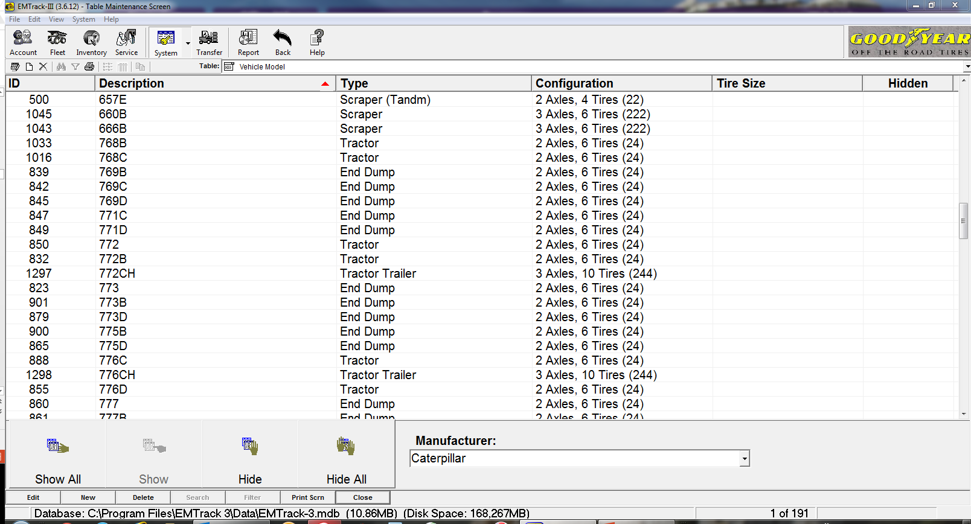
Add a new vehicle model
Vehicle editor screen
Click “system” (or press F6)
Vehicle model
If you have to add a new model, click “new”
Models available
Select the manufacturer
Notes:
The vehicle database is “not up to date” !
We are working on it.
It’s possible to add a vehicle / model.

Slide 23
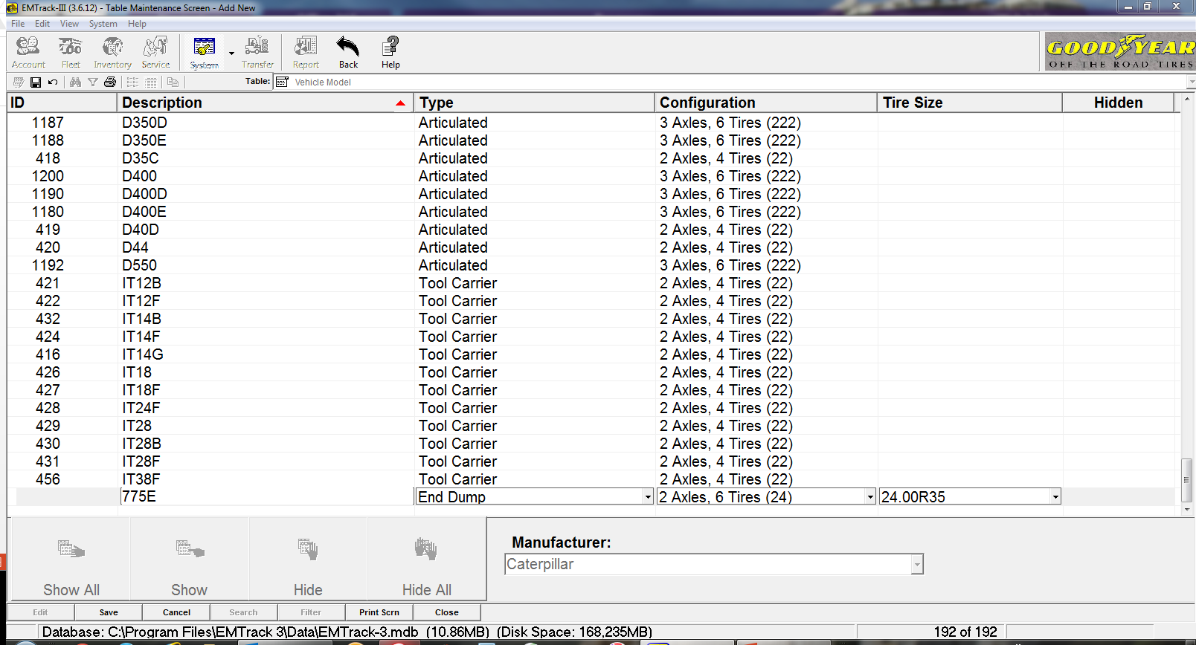
Add a new vehicle model
Vehicle : create a new model
Fill the model
Select the type
Select the configuration
Select the tire size
Click save to finish
Notes:
Big problem today : no reach stackers (2 axles, 6 tires) in config. (42)

Slide 24
Delete a vehicle
Delete a vehicle
Shortcuts & remarks :
Add a new vehicle : ctrl + A
Open a vehicle : ctrl + O
Delete a vehicle : ctrl + D
Delete a vehicle needs to dismount de tires first (return to customer’s inventory)

Slide 25
Tires & rims
3.tires

Slide 26
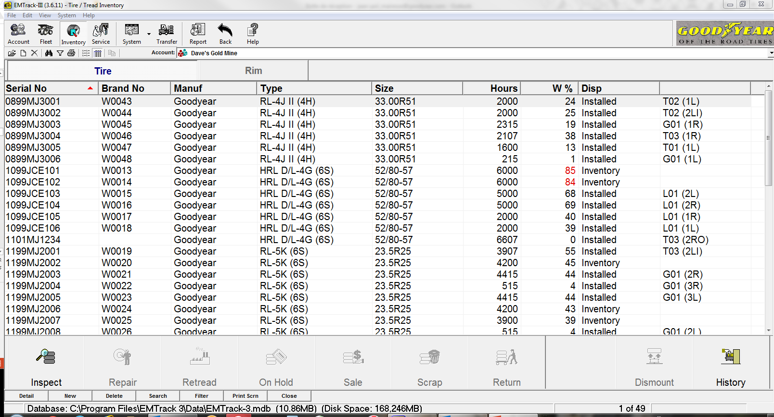
Tires inventory overview
Tire inventory screen
Customer
Customer’s inventory
Click “New” to add/create a tire
Notes:
View of the already existing tires in the selected customer’s inventory.
If a size/design you need, oint the line and click “NEW” Many data will be kept and already filled in the tire edition screen.

Slide 27
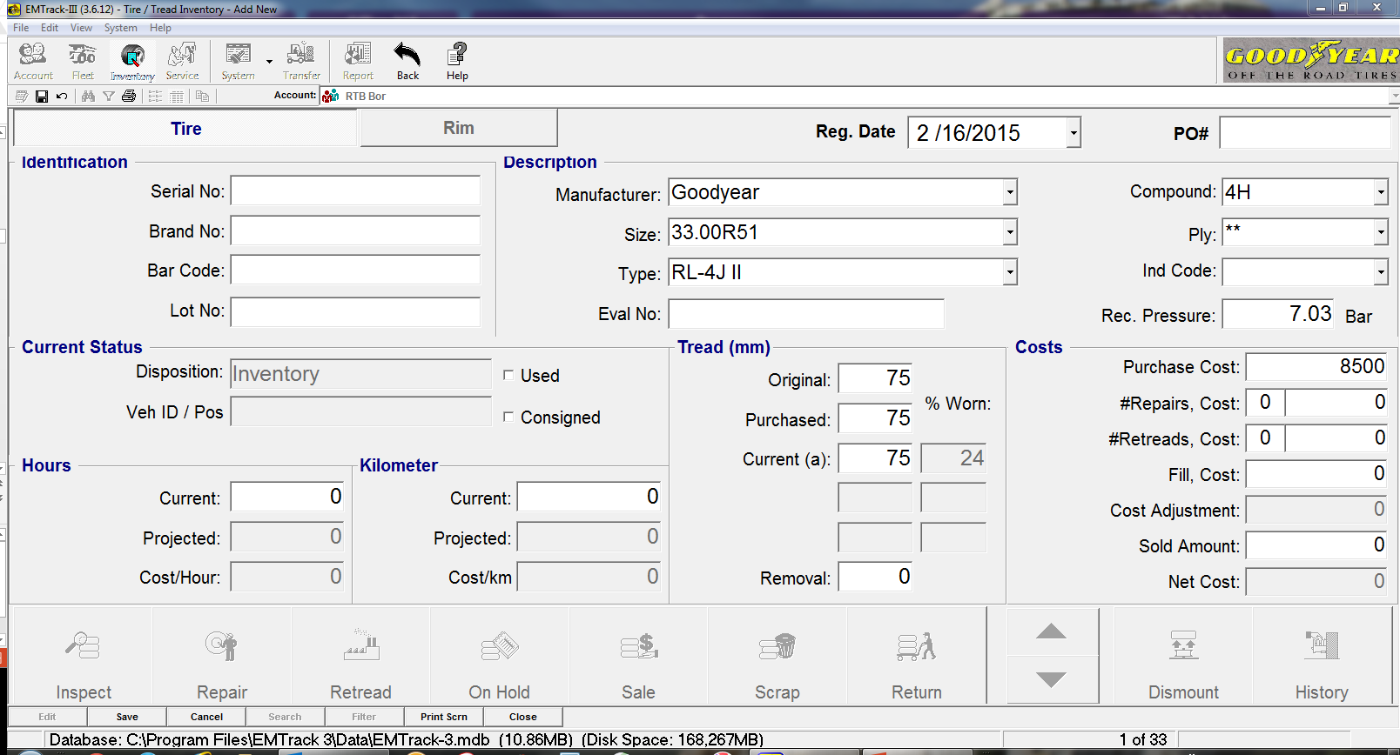
Tires editor screen : creation of tires
Tire editor screen
Registration date
Serial #
0113MJ0117
Select tire data
NSK
Price
hours
Click “Save” to finish
Notes:
It is possible to create tires before the vehicles, but not really interesting…

Slide 28
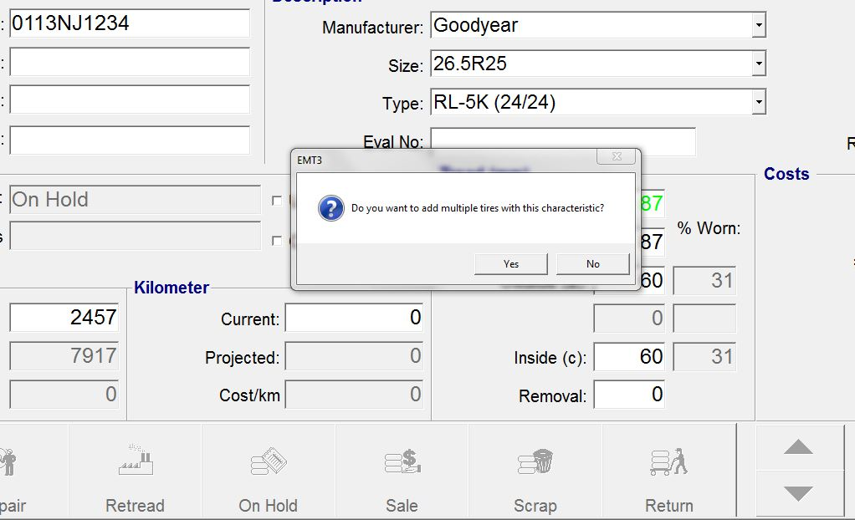
Tires editor screen : creation of tires
Tire editor screen
Notes:
This function can be interesting if there are many same tires in service at the same customer
You have to fill the serial number but : all the data you’ve filled on the “copied” tire will be also copied (measured RNSK, recommended pressure, hours,etc…) They have to be changed/Adapted when you’ll install these tires on a machine !!!

Slide 29
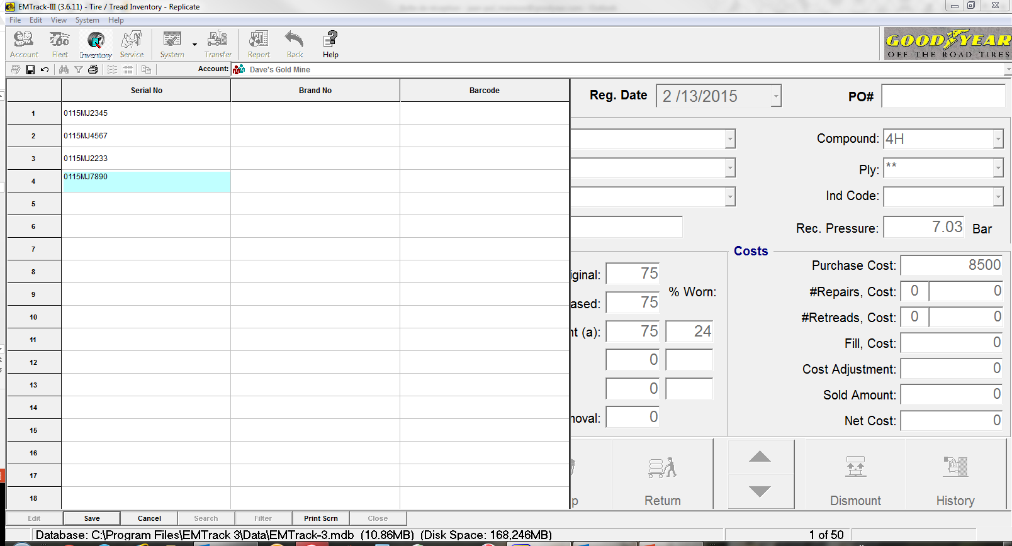
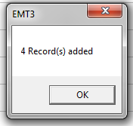
Tires inventory : creation of tires
Tire editor screen
Notes:
In blue : serial # to be filled
Click on “save” > popup : “X records added”

Slide 30
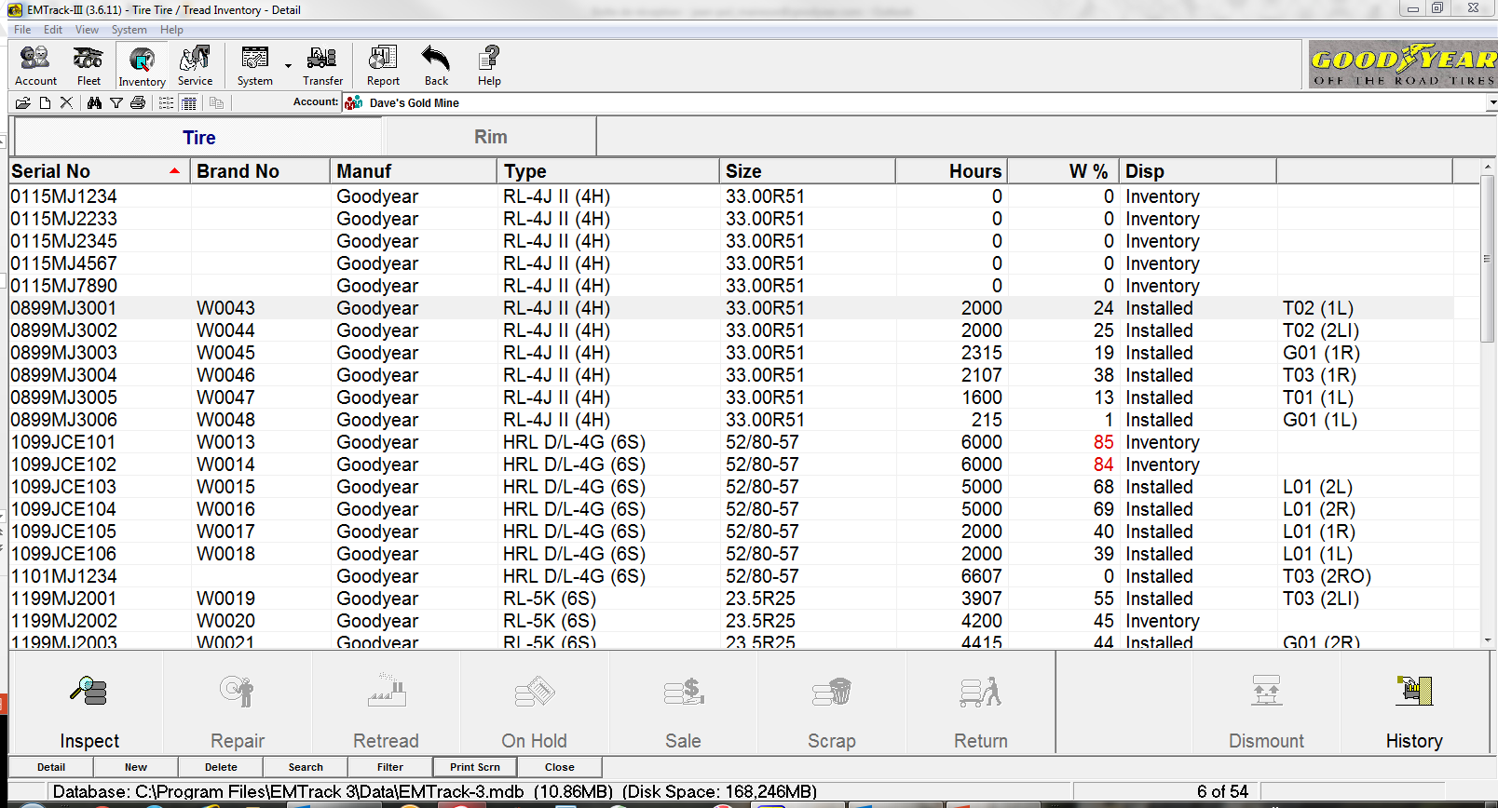
Tires inventory overview
Tire inventory screen
The new tires are now in the inventory
Notes:
Competitor tires : all the data must be available (ONSK…)

Slide 31
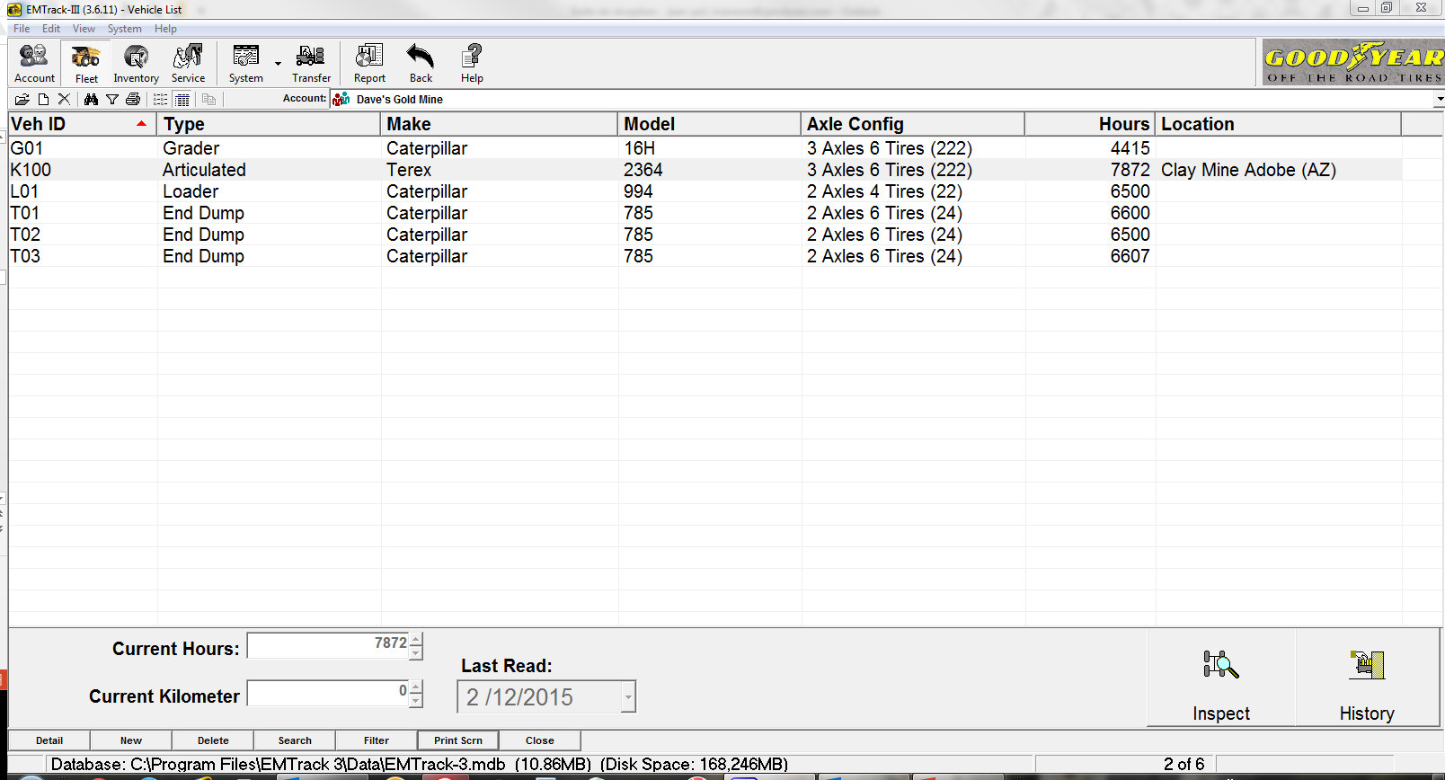
Installing tires
Install tires on a vehicle
Customer
Select the vehicle
Click “Inspect”
Notes:
Click on “FLEET” – Be sure that you work with the correct customer, otherwise, you won’t find the machine and the tires.
Select the machine and click on “INSPECT”

Slide 32
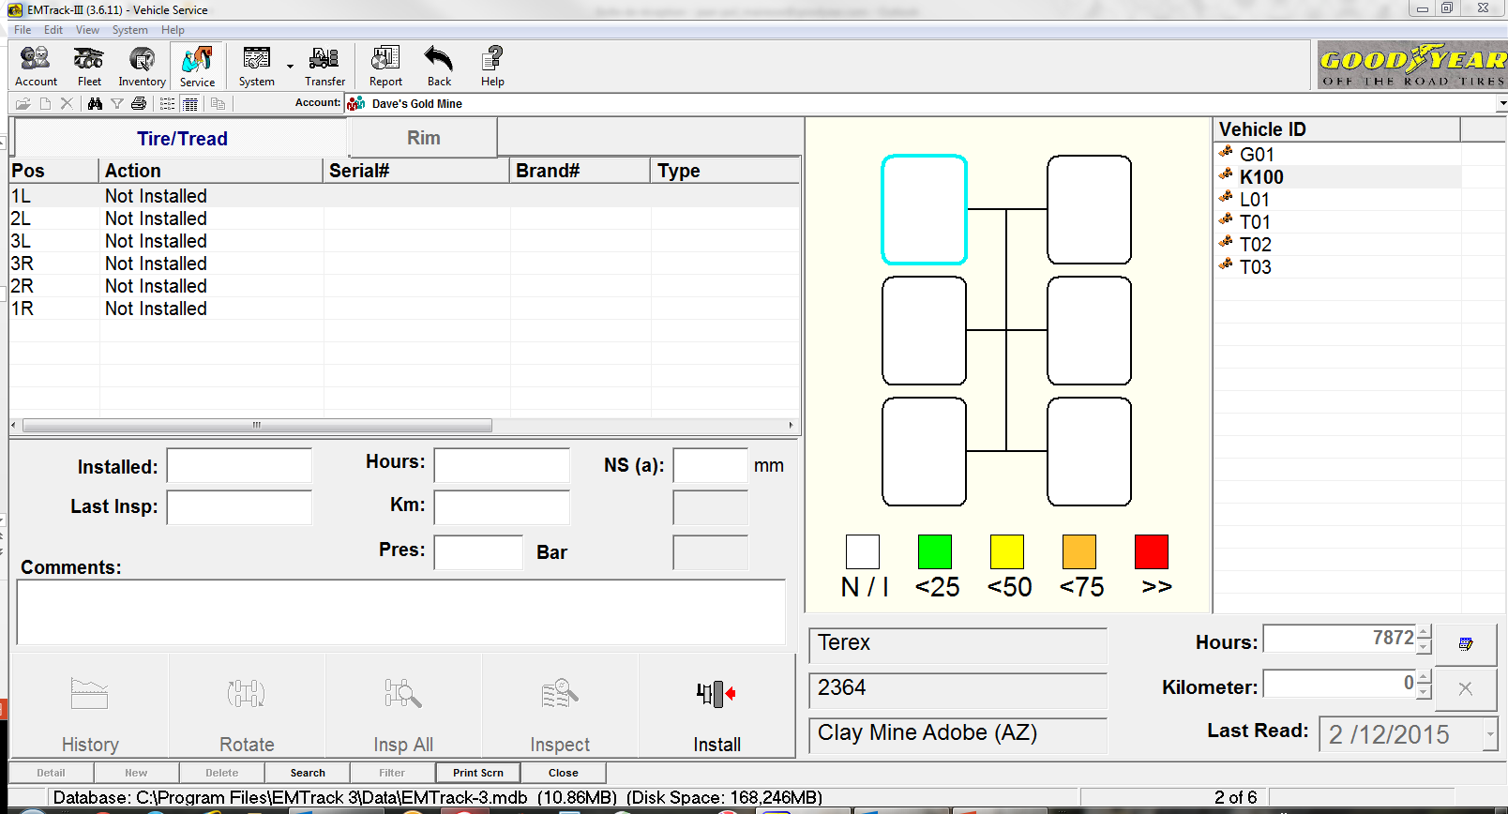
Installing tires
Install tires on a vehicle
Click “Inspect”
Select a position and then “INSTALL”
Notes:
Select the position and then “INSTALL”

Slide 33
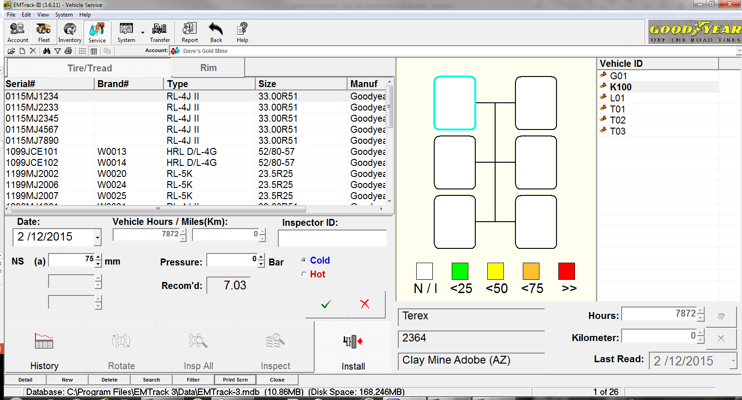
Installing tires
Install tires on a vehicle
Select the tire you want to install
Notes:
Only the available tires owned by the customer are visible (= tires in the inventory).
Are not available for installation, the tires in one of the following situations :
-scrap
-on hold
-repair
-retread

Slide 34
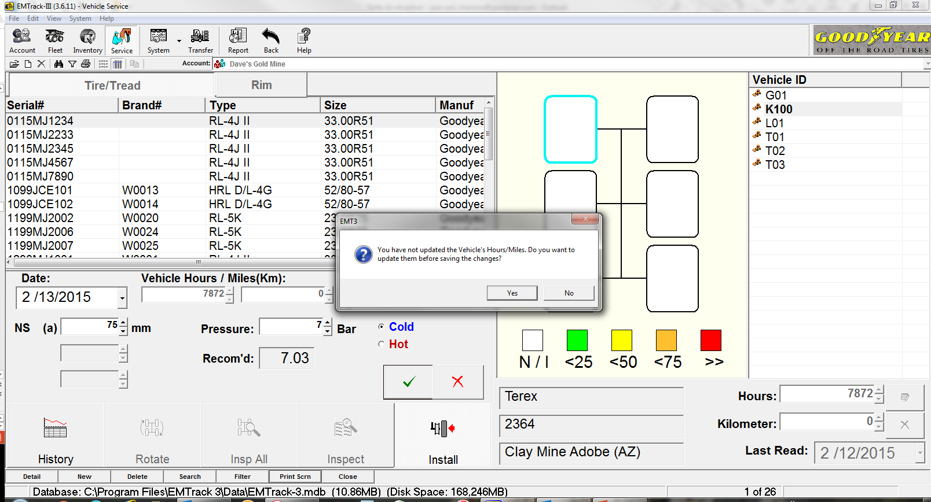
Installing tires
Install tires on a vehicle

Slide 35
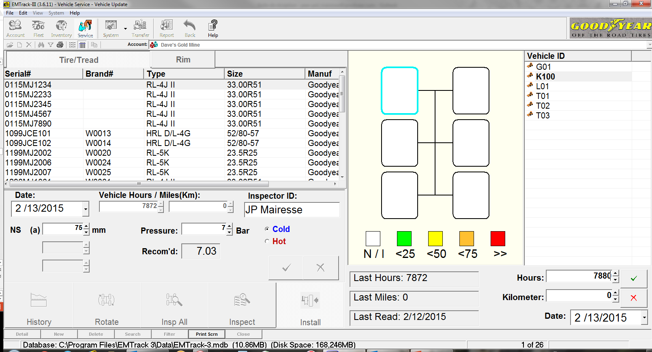
Installing tires
Install tires on a vehicle
Update the data and click on the green “V”.

Slide 36
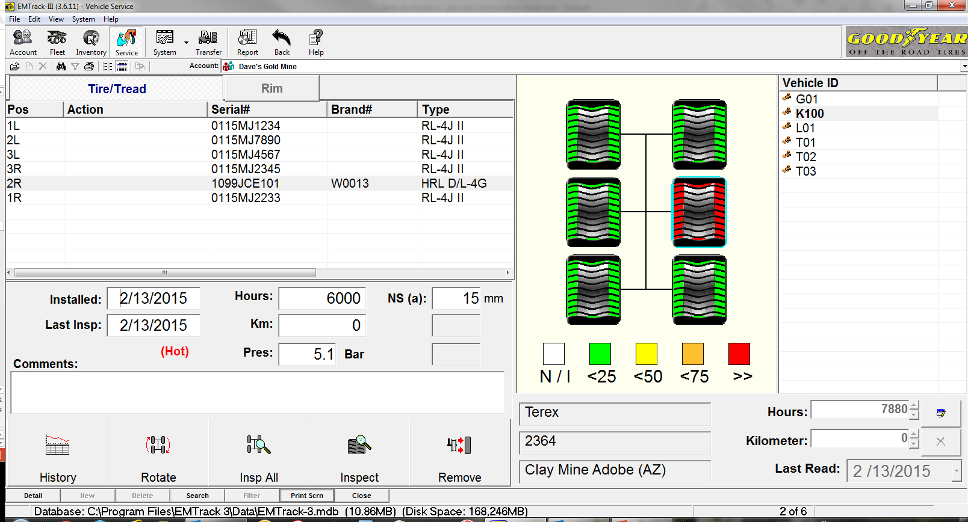
Installing tires
Install tires on a vehicle

Slide 37
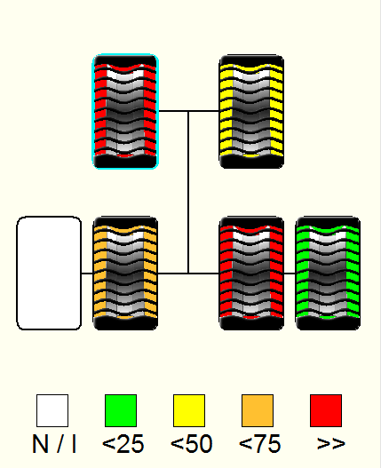
Wear % in color
Colors vs wear %
No tire installed
Wear % : less than 25%
Wear % : 26% - 50%
Wear % : 51% - 75%
Wear % : 76% - 100%

Slide 38
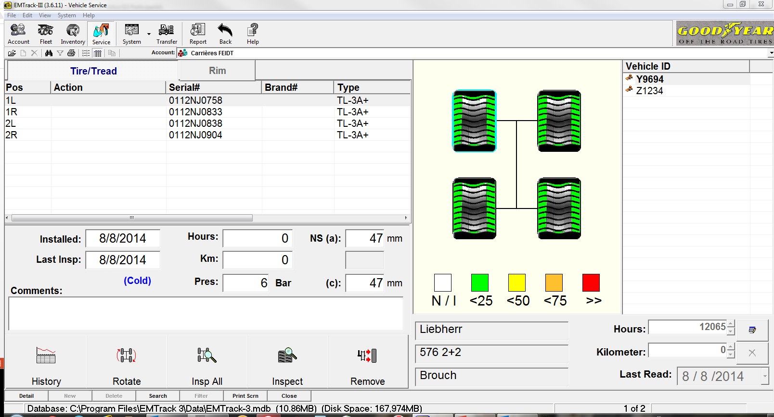
Tires management : filling data after inspection
Tires inspected : filling the data
Click “inspect all”
Notes:
Click on the “SERVICE” icon, select the customer (1)
In the “Vehicle ID” list (on the right side) , select the involved machine (2).
You get now the view of the inspected machine

Slide 39
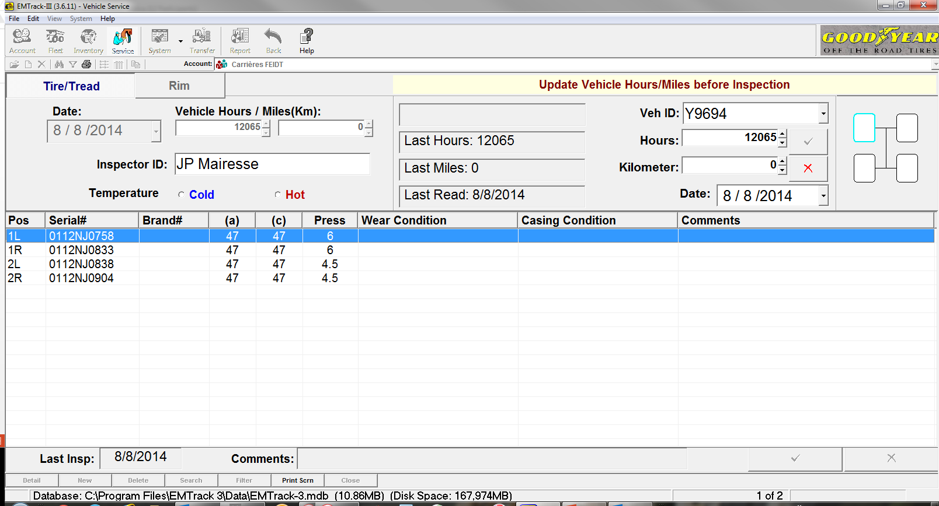
Tires management : filling data after inspection
Tires inspected : filling the data
Step 1

Slide 40
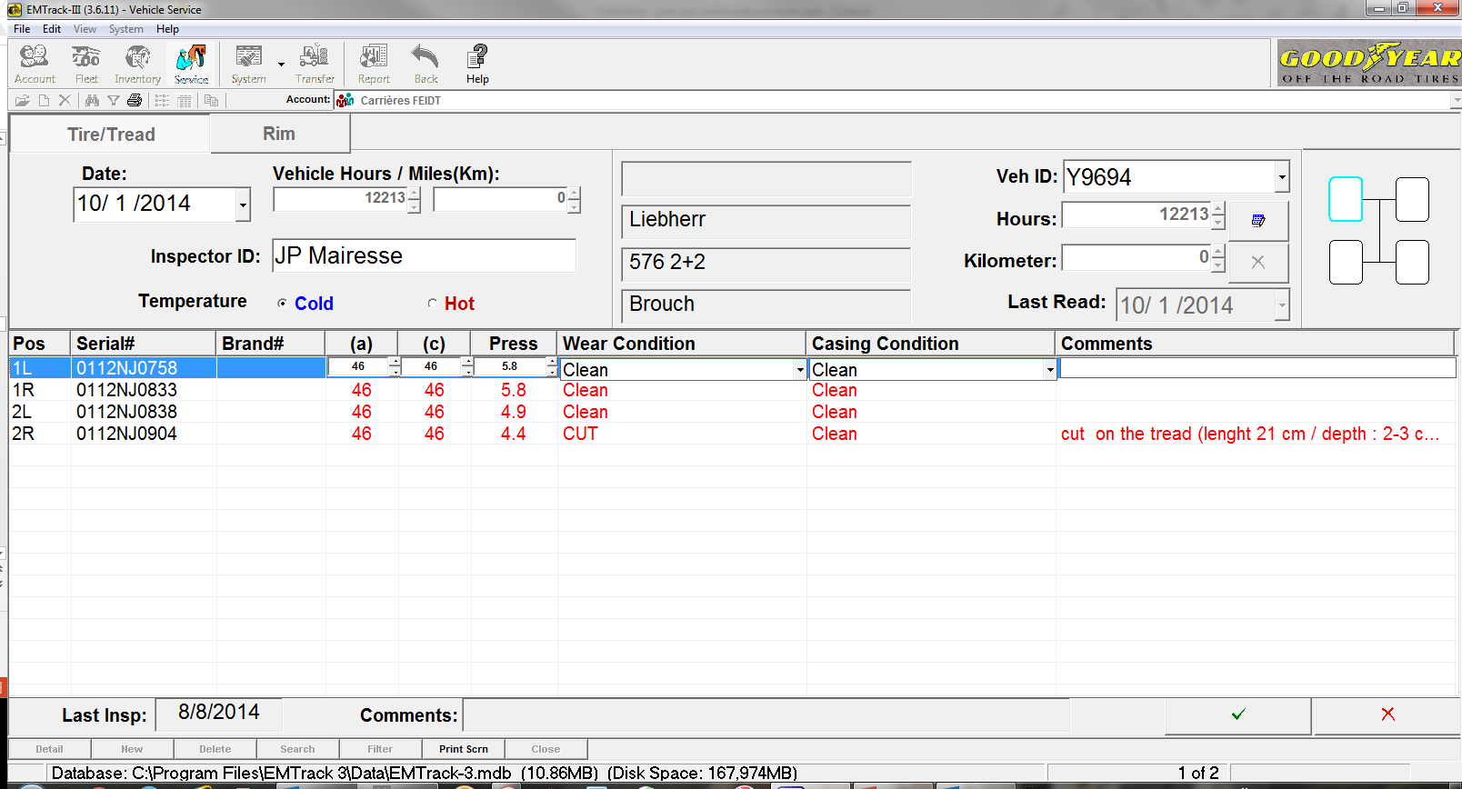
Tires management : filling data after inspection
Tires inspected : filling the data
Measurements after your inspection
To be used
(if needed)
Added comments (if needed)
Click here to save
Notes:
Visit on Oct.,10,2014 (Previous : 8/8/2014) - 148 hours in service in this example.
Now that the date & the hour are updated, choose the correct “TEMPERATURE”

Slide 41
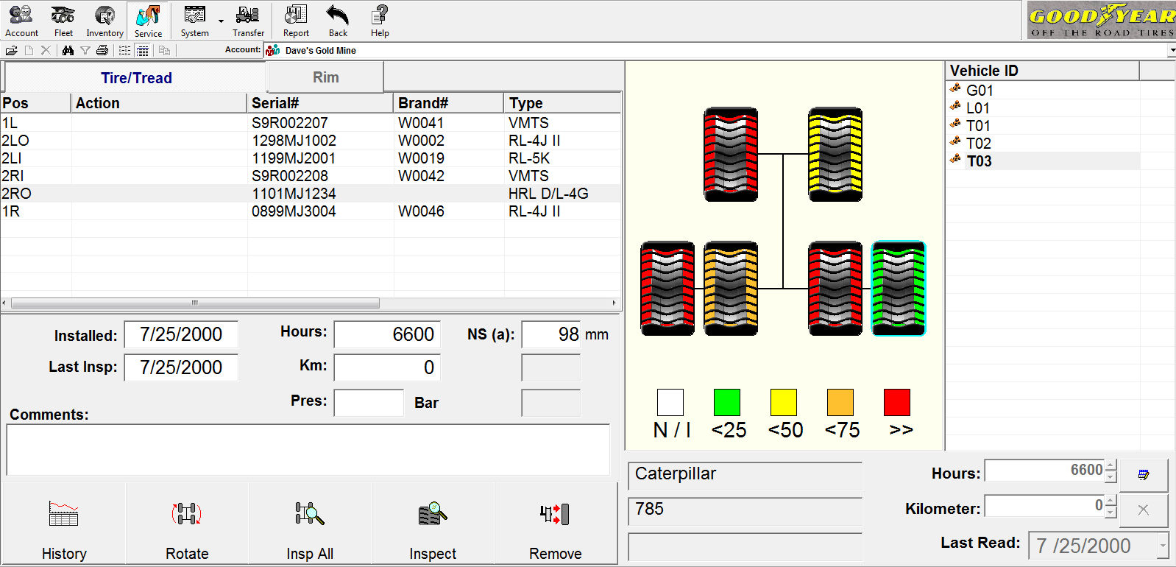
Tires management : dismounting
Dismounting a tire
Select the tire to be dismounted
Click “Remove”
Notes:
You may remove a tire for different reasons :
-to repair
-to retread
-to scrap
-for a claim (“On hold”)
- The customer sold / transferred the tire

Slide 42
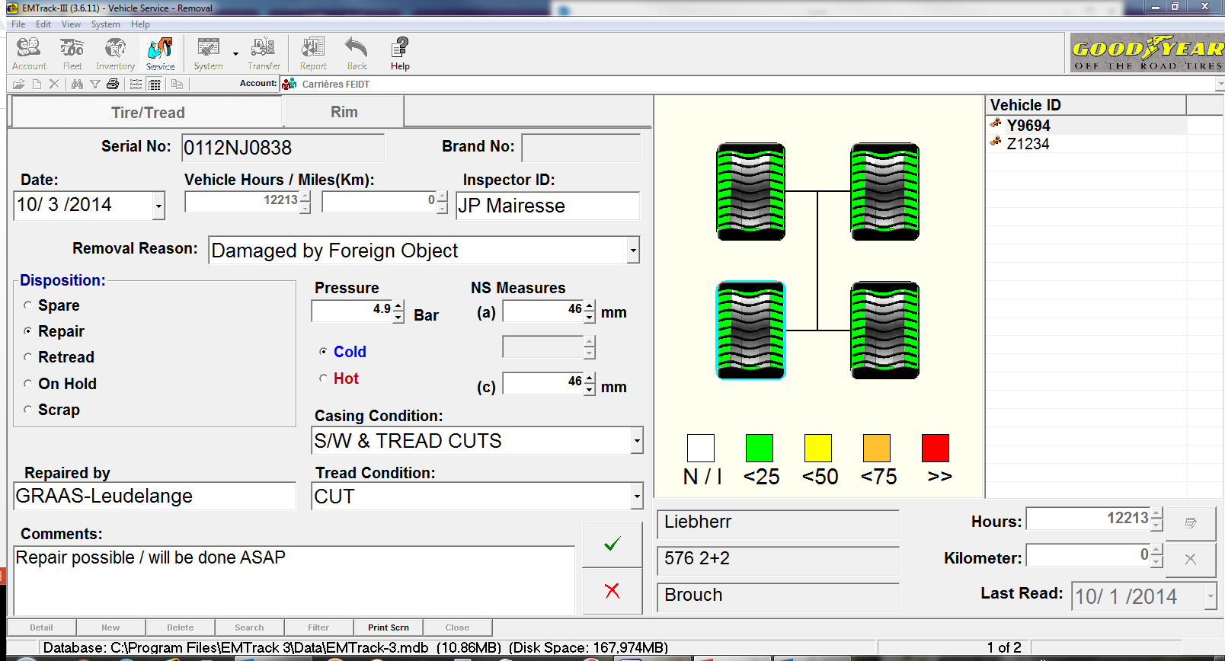
Tires management : dismounting
Dismounting a tire
Notes:
Fill available information (as much as possible).

Slide 43
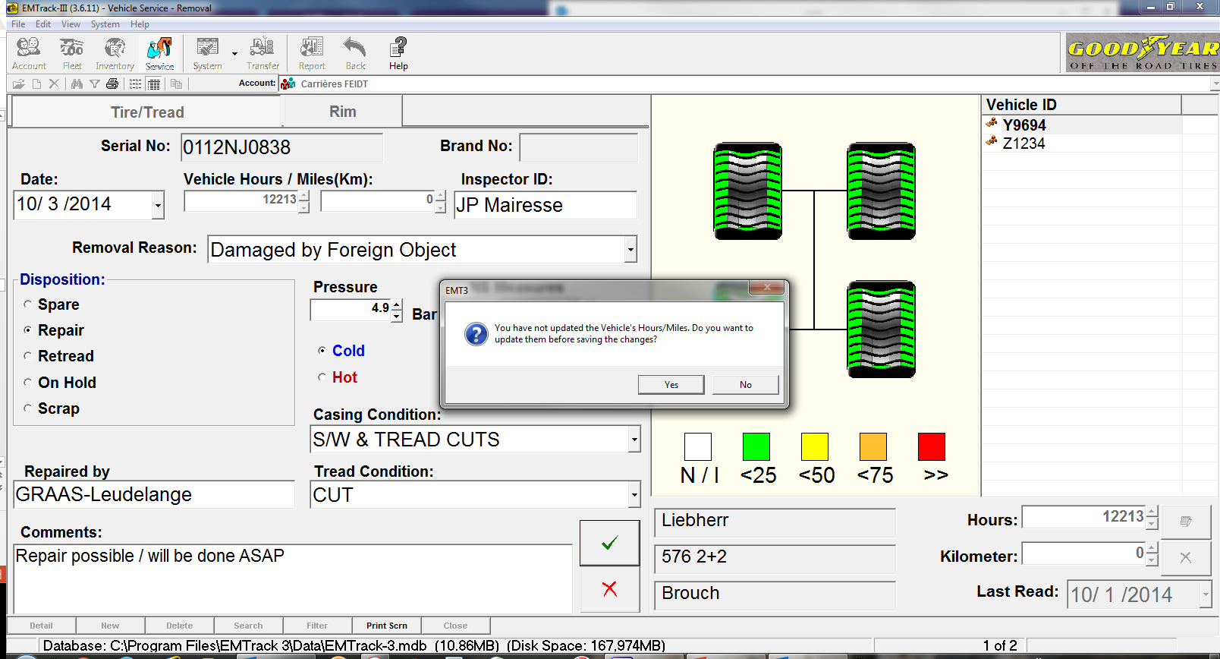
Tires management : dismounting
Dismounting a tire

Slide 44
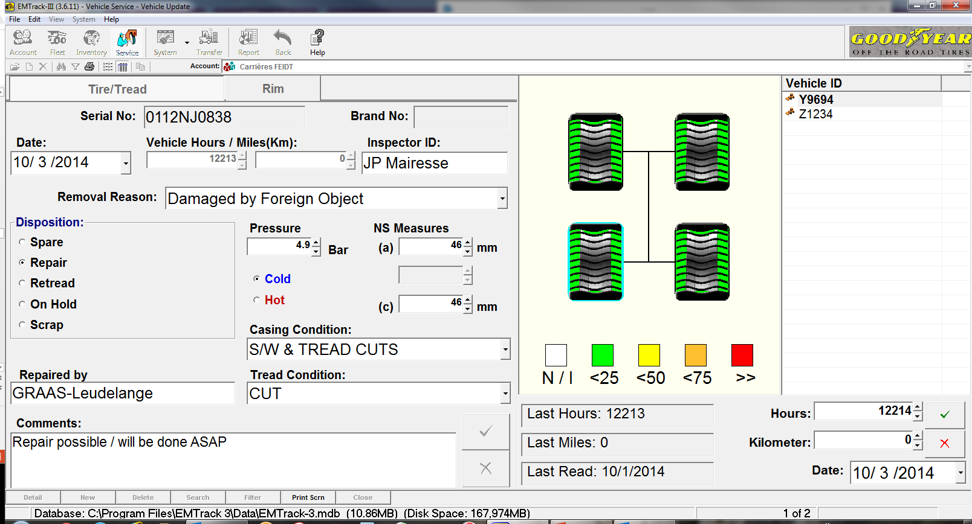
Tires management : dismounting
Dismounting a tire
Notes:
You have to CHANGE the Hours (add one hour at least)

Slide 45
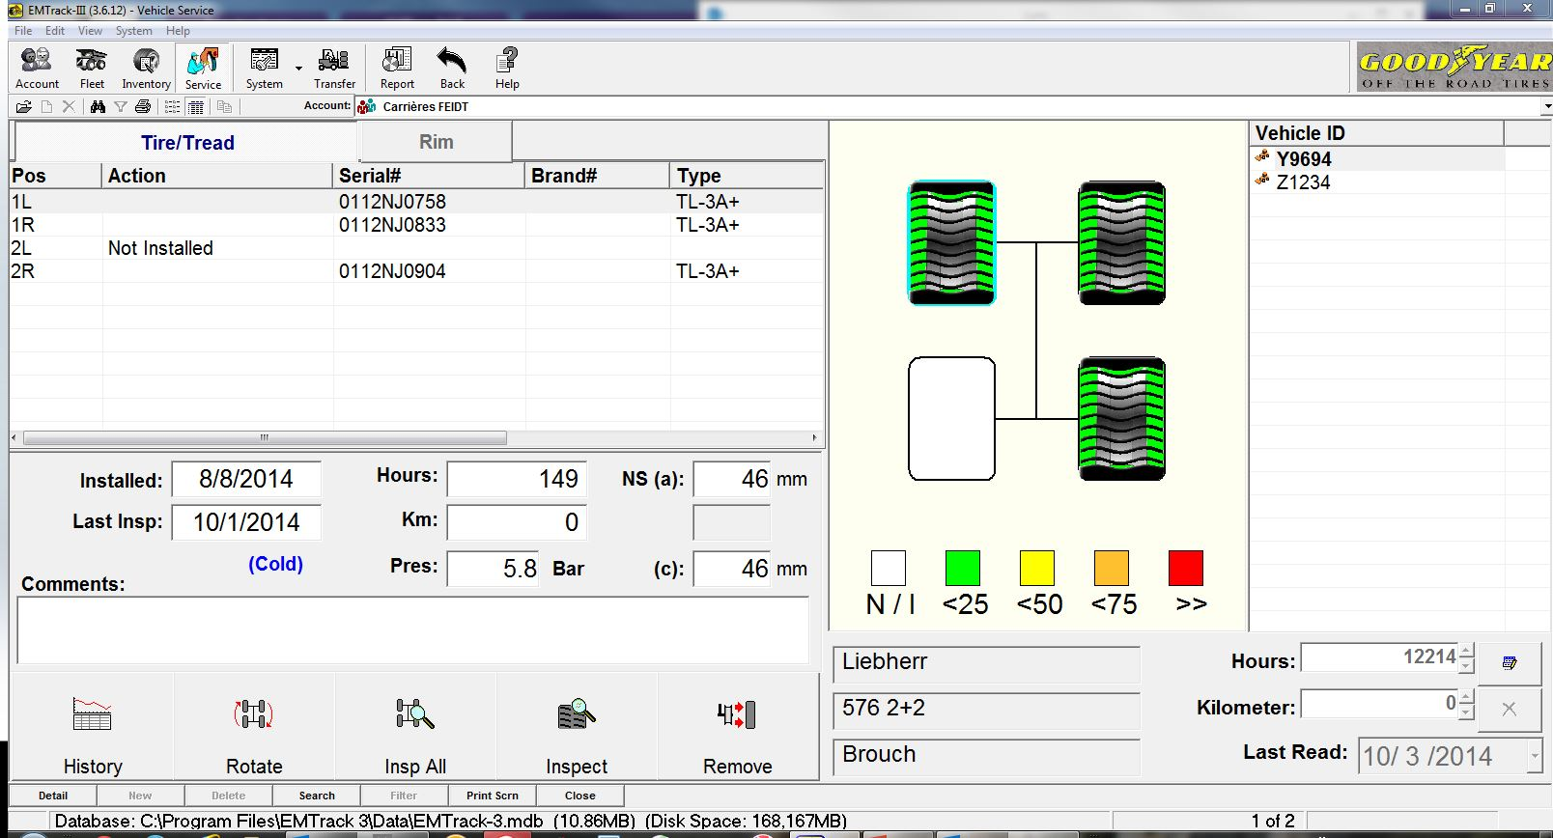
Tires management : dismounting
Dismounting a tire
Notes:
Don’t forget to remount another tire.

Slide 46
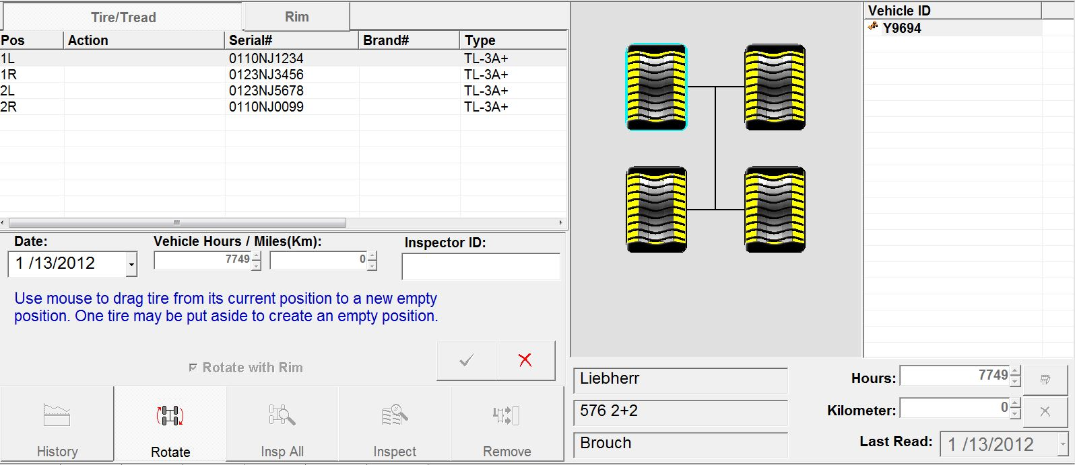
Tires management : rotating tires
rotate / position changes

Slide 47
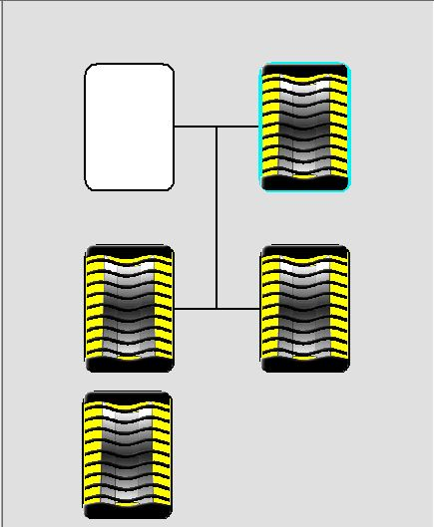
Tires management : rotating tires
Machine : rotate / position changes
1L >< 2L
1R >< 2R
The tire pos.1L is put aside to create and empty position. The tire 2L is dragged on position 1L, and the tire apart is dragged on position 2L
Notes:
Rotation of tires :
From 1L to 2L , idem for the right side
Must be done tire per tire !!!!

Slide 48
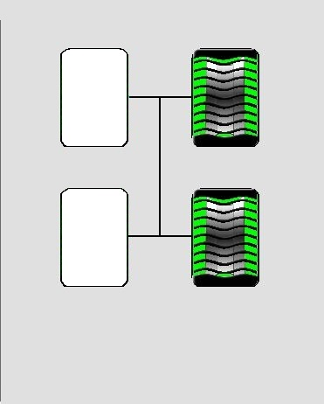
Tires management : rotating tires
Rotating / positions changes
Rotation / exchange between A & B positions (as example) :
The tire “A” (1L) is put aside (click and drag)
The tire “B” (2L) moves from its original position to the 1L.
The tire “A” is mounted on the position 2L.
The rotate process is only possible to be done on one machine. In case of exchanges between 2 different machine, use the dismounting / mounting procedure.
Rotation finalized

Slide 49
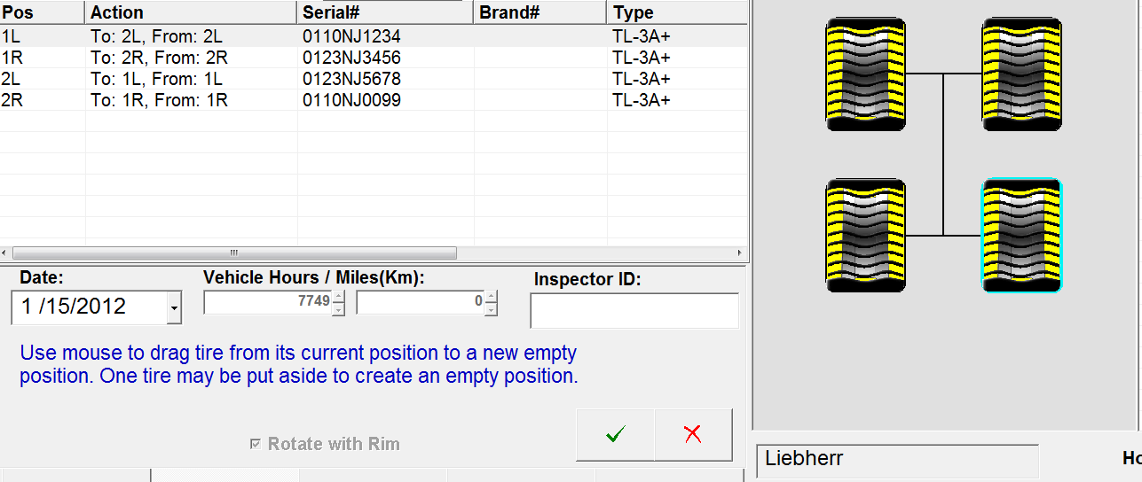
Tires management : rotating tires
Machine : rotate / position changes
Changes positions

Slide 50
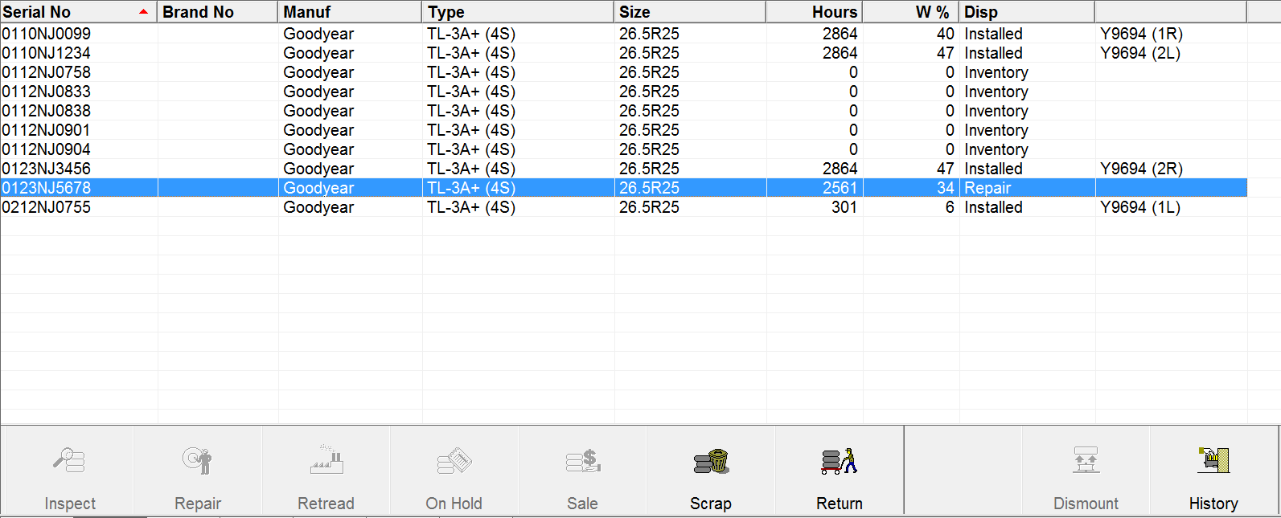
Tires management : rotating tires
Tire return to inventory
A tire sent to repair (or retreat, etc..) must return to the inventory before it can be remounted on a machine. Click on “return”.
Notes:
When a tire is not available in the inventory (repair / on hold / Scrap…), before to be reused, it must come back to inventory.

Slide 51
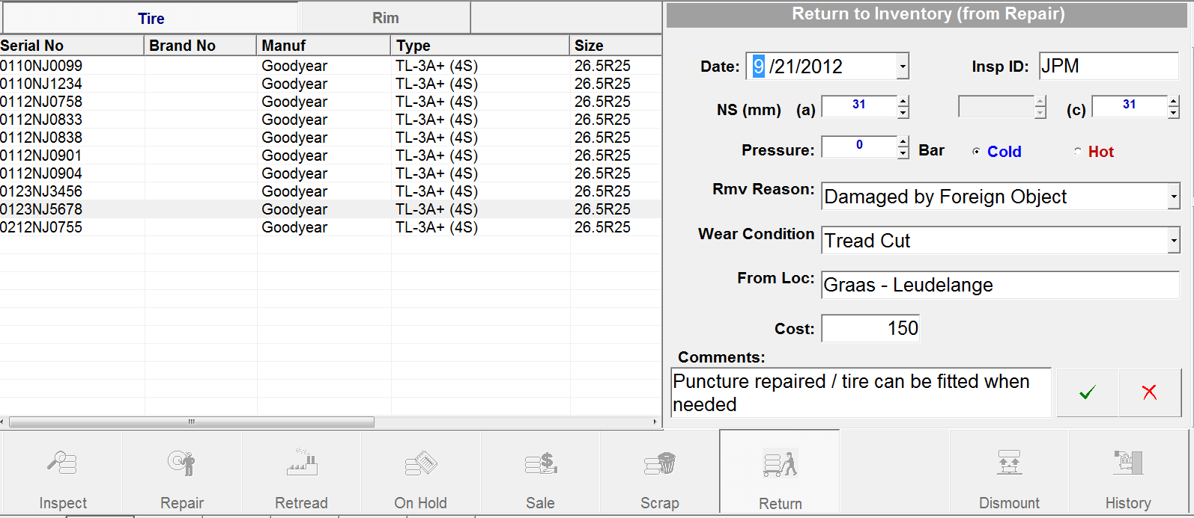
Returns
Tire return to inventory
Additional information can be filled to complete historic data :
Date of the return / cost / comments.

Slide 52
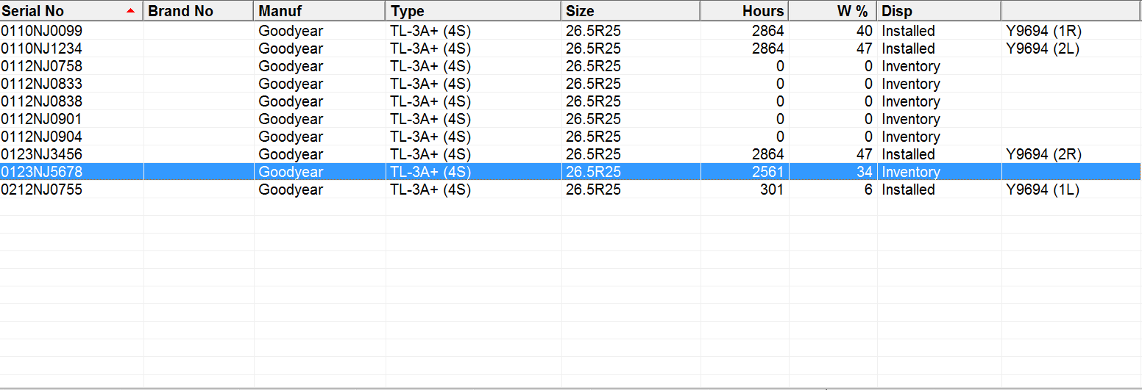
Returns
Tire return to inventory
The tire is back to the inventory

Slide 53
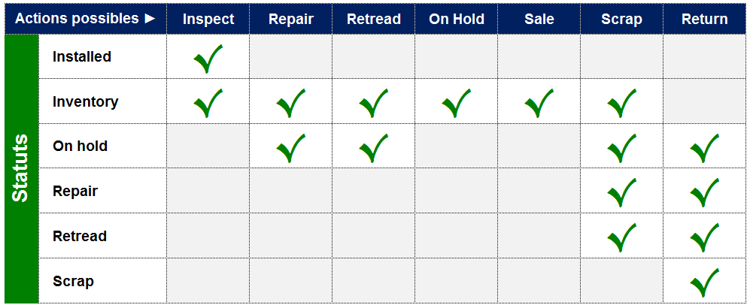
Returns
Tire return to inventory

Slide 54
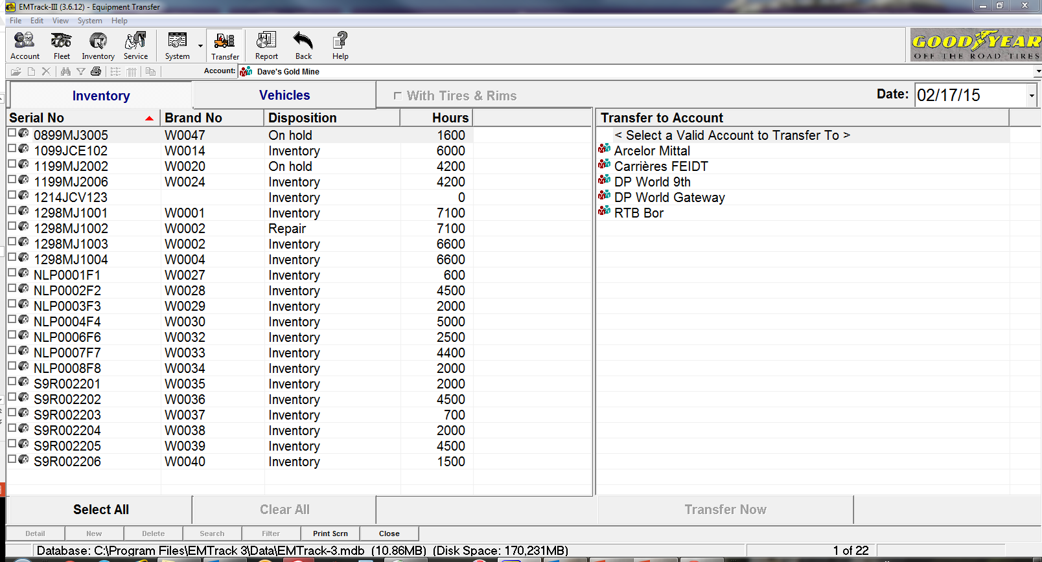
Transfer
Transfer : tires
Original customer

Slide 55
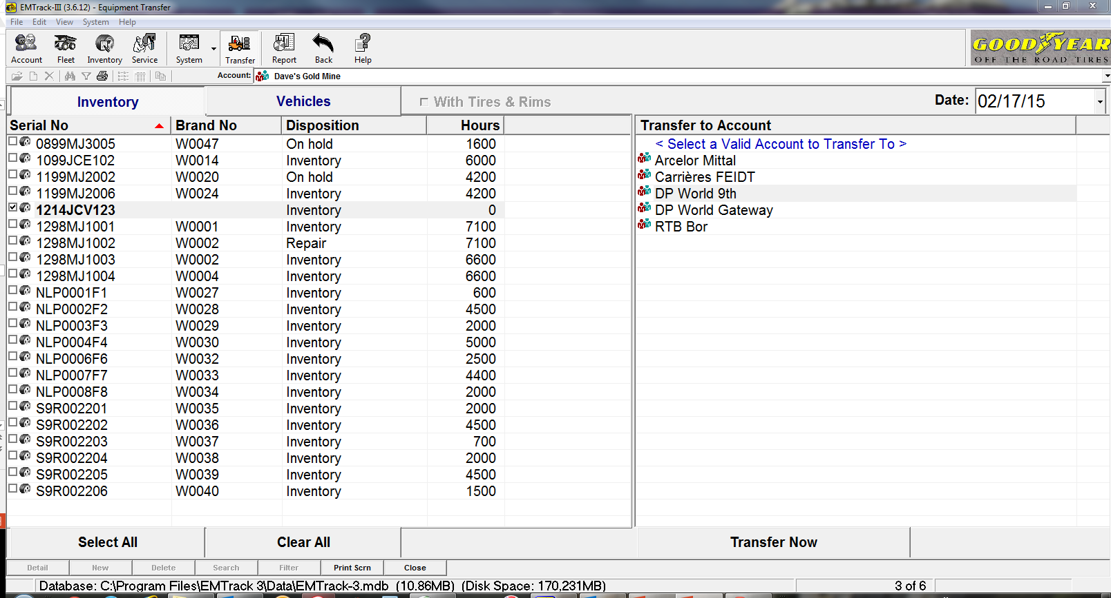
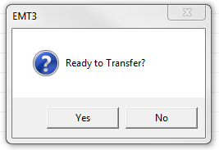
Transfer
Transfer : tires
Current account
Transfer date
Select the tire(s) you will transfer
Select the final account
The tire is transferred to the final account inventory
Click “transfer now”
Notes:
- Only non-installed tires can be transferred.
-Transfer of tires means that the customer who will receive the tires is already existing in the accounts list…

Slide 56
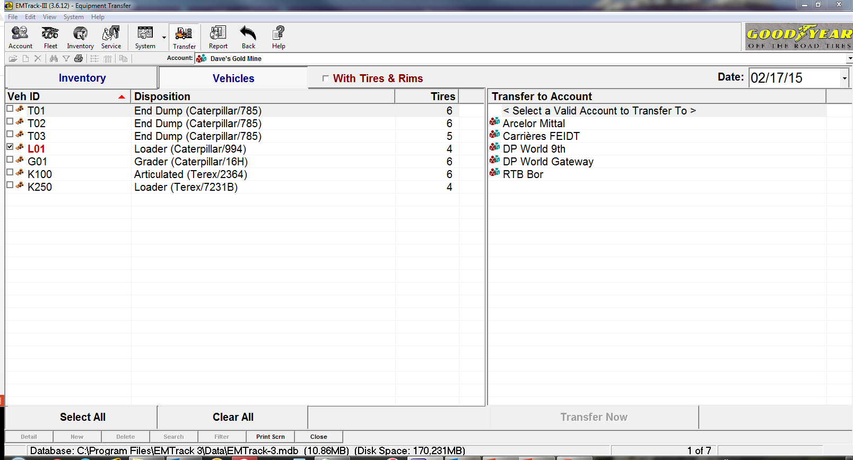
Transfer
Transfer : vehicles
Current account
Transfer date
Transfer with tires and rims ?
Select the vehicle(s) you will transfer
Select the final account
Notes:
Transfer with tires & rims :
If yes, the vehicle is transferred as it was at the “Current account”.
If NO = Split between tires/rims & vehicle :
the tires will be transferred to the current account inventory
the vehicle is transferred to the final account without wheels. The four positions (here in this sample) will be “blank” on the vehicle service screen.

Slide 57
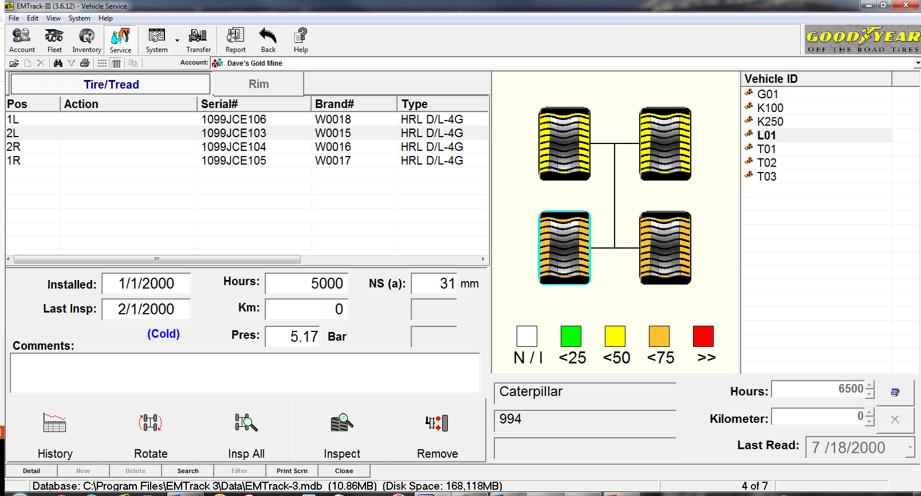
Tires history
Tire History

Slide 58
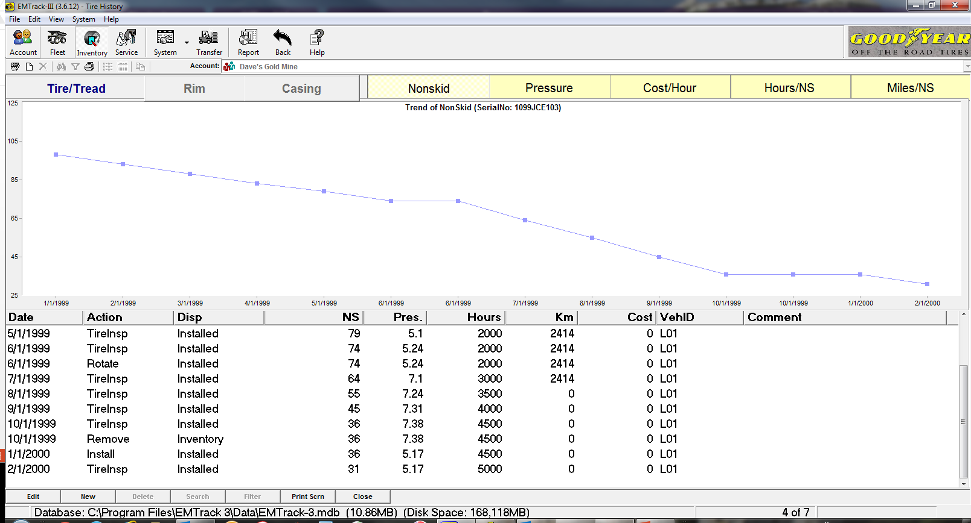
Tires history
Tire History
Tire History

Slide 59
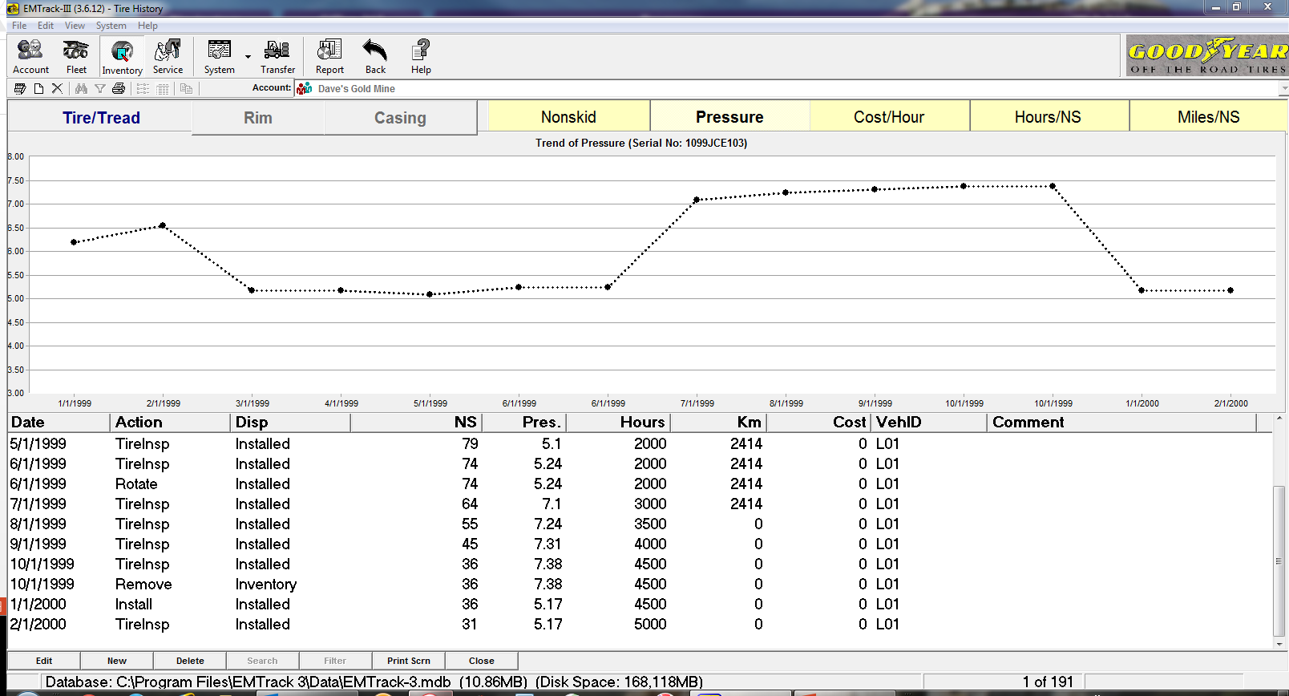
Tires history
Tire History

Slide 60
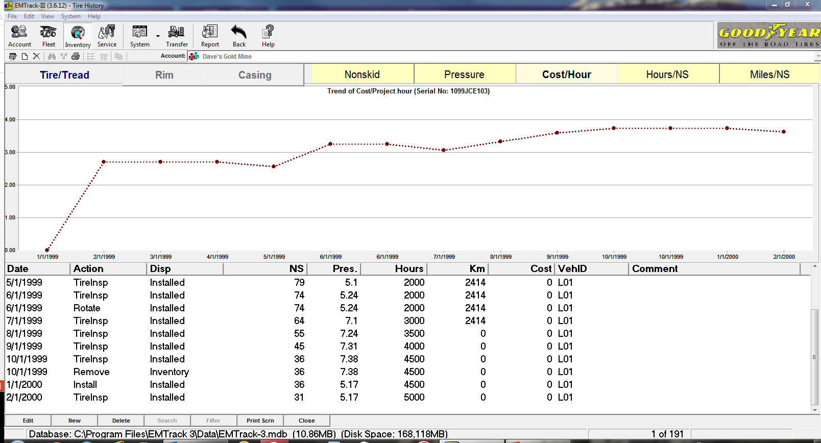
Tires history
Tire History

Slide 61
Reporting
4.Reports

Slide 62
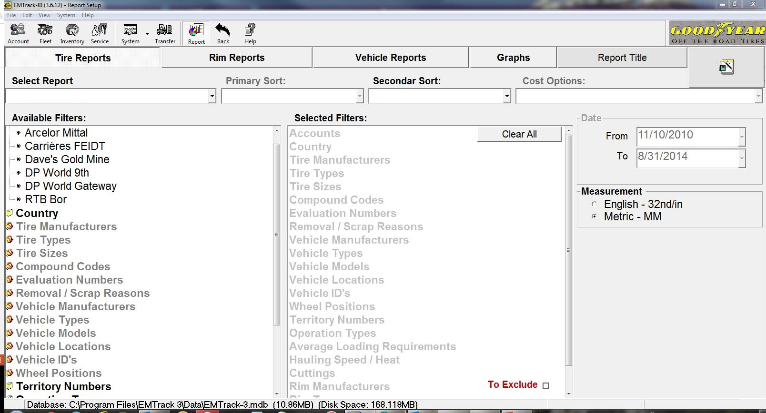
Reporting
Reports : main page
Tires
Rims
Vehicles
Graphs
Notes:
Main title & available filters

Slide 63
Reporting
4.1.Reports by tires

Slide 64
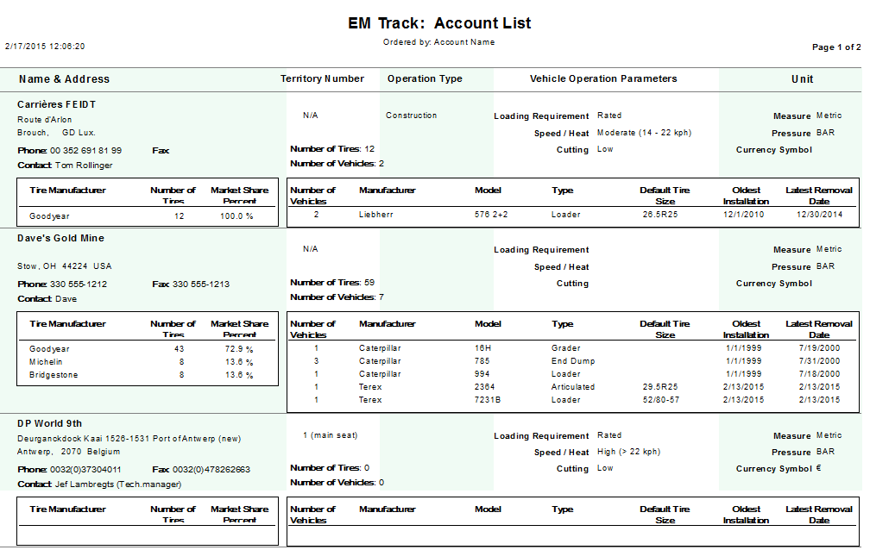
Reporting
Reports : accounts list
Notes:
Here you see al the tires in your database, customer by customer. It’s possible to select one or more customers, following what you want to do with this report. You have here the amount of tires only, with the different vehicles. I’s an OVERVIEW with less details.

Slide 65
Reporting
Reports : tires in service
Uncheck “Excel Raw Data”
Notes:
Uncheck “Excel Raw data”, otherwise, it is NOT possible to select another format !

Slide 66
Reporting
Reports : tires in service

Slide 67
Reporting
Reports : scrapped tires

Slide 68
Reporting
Reports : tires repaired (costs incl.)
Etc…etc…

Slide 69
4.2.Tires forecast
JP Mairesse
Technical trainer EMEA
Commercial tires

Slide 70
Reporting : tires forecast
Reports : tires forecast
Tires
Filters
Notes:
09 : Tire Forecast report / account name / Vehicle ID / Original + retread + repair - adjustment

Slide 71
Reporting : tires forecast
Reports : tires forecast

Slide 72
Reporting : tires forecast
Reports : tires forecast
(Extract)
Feb.,17,2015
Many calculations & data available

Slide 73
Reporting : 23 - tires forecast
Reporting : Tires needs forecast
Notes:
A forecast can be done :
-by customer(s) – one or more
-by tire size (selection possible)
-by vehicle ID
-by tire type, etc…

Slide 74
Reporting : tires forecast
Reporting : Tires needs forecast – by year

Slide 75
Reporting : tires forecast
Reporting : Tires needs forecast – by month

Slide 76
Reporting : tires forecast
Reporting : Forecast / tires needs
Notes:
I want to know the tires needs for all my customers, for the years 2015-2020 (…), with the costs (calculated with the prices I filled in the tires database)

Slide 77
Reporting : tires forecast
Reporting : Forecast / tires needs

Slide 78
Reporting : tires forecast
Reporting : Forecast / Tires needs
Notes:
Tires reports [23 : Tire Needs Forecast Report] – tires sizes selected – Show costs

Slide 79
Reporting : tires forecast

Slide 80
Reporting : tires forecast

Slide 81
Reporting : by vehicles
4.3.Reports by vehicle

Slide 82
Reporting : 102 – Fleet survey
Reports : fleet survey

Slide 83
Reporting : 102 – Fleet survey
Reports : fleet survey

Slide 84
Customer’s fleet data collection
Customer’s fleet data collection
Notes:
Customer’s fleet data collection :
In the “Report” chapter, Select “Vehicle Reports”
In the table “Select Report”, choose 103 : Fleet Data Collection
Select the customer and click on the report button > pop up with 2 options (see next slide for more details).

Slide 85
Customer’s fleet data collection
Customer’s fleet data collection
Option 1 :
Option 2 :
Select a configuration
Form with existing data
Notes:
Option 1 : you will get personalized form for the customer(s) you selected (see next slide for further details).
Option 2 : you may select a configuration in the list to create an empty form.

Slide 86
Regular report form (existing data)
Data to fill
All the data previously introduced are available on the form : you just need to complete it with the measurements you will collect during your fleet survey.
Notes:
Option 1 : you have already available data recorded in EM Track.
As you print the regular report form, you’ll find what you recorded previously. You just need to update the info.

Slide 87
Reporting : graphs
4.4.Graphs

Slide 88
Reporting : graphs & filter selection
Reports : graphs

Slide 89
Reporting : graphs & filter selection
Reports : graphs
In service by Vehicle ID
In service by Vehicle manufacturer
Projected cost by tire size
Forecast by tire type
Forecast by tire size…
46 different filters are available
Notes:
Tires in service / all brands and sizes / all customers > hours per mm (easy to calculate a cost/hour)
Can be done – of course – customer by customer
Note that not all reports / graphs are affected by all filters. If you notice while running a report or graph that no or limited data appears, please check your filter settings.

Slide 90
Reporting : graphs & filter selection
Reports : graphs
Notes:
Example of a graph for Dave’s Gold mine / by tire type-size /projected cost (in the selected currency)

Slide 91
Bridgestone (18 tires)
1.24
1.32
1.07
Michelin (24 tires)
Goodyear (32 tires)
(74 tires)

Slide 92
5.Backup & import

Slide 93
Save & share data
Sharing data : Backup & import
Notes:
Click “Backup”

Slide 94
Save data : backup
Saving your data : Backup
You can select one or more customers or all customers by clicking “Select All”
Backup without costs/prices
You can select one or all tires brands
Notes:
Not possible to select TWO tires brands !

Slide 95
Save data : backup
Save your data : Backup
Choose where you want to save your backup They will be saved in .mdb format
File name must be changed (Every backup is always created under the generic naming “Emt3Back.mdb”)

Slide 96
Save data : backup
Sharing data : Backup & import
Backup completed : confirmation by popup

Slide 97
Import data
Data import

Slide 98
Import data from a file
Data import
Click “import” and select the file you want to import

Slide 99
Import data from a file
Data import
You can select one or more customers or all customers by clicking “Select All”

Slide 100
Import data from a file
Data import
(All customers selected)
Click “import”

Slide 101
Import data from a file
Data import
When “import” is completed, the data are now on your EMTrack III system

Slide 102
Customer’s fleet data collection : blank form
02/28/2015
Lhoist Jemelle (BE)
JPM
RDT 761
CATERPILLAR 775D
22451
24.00R35
GOODYEAR
RT – 4A+
**
4S
29/32
Cold
0914NJ0776
1873
E-4
31/32
Recommended pressure (cold) : 7.5 bar / 750 kPa / 110 psi
100
Default removal NS : 13/32nds / 10 mm
Heel & toe
Your collected data are completely filled and ready to be registred in EM Track.
Notes:
A blank form is also available : fill the data and register them in EM Track. You will get a prepared form for the next visit.

